Slide 1


Evolving research & its importance in the Tech Industry
Anish Mahapatra | 20 November, 2021

Slide 2

Agenda
01
Introduction
02
Why do research?
03
The end to end process
04
Move into Data Science
05
Tools & Technologies, Job strategies and CTC
06
Let’s Talk!

Slide 3











Topic 1 of 6
Introduction
Senior Data Scientist
LinkedIn: www.linkedin.com/in/anishmahapatra Medium: anishmahapatra.medium.com Website: www.anishmahapatra.com
GitHub: www.github.com/anishmahapatra
Q. How to get into Data Science?
A. Simple, ask a real-world Data Scientist.

Slide 4




Topic 2 of 6
Why do research?
01
02
03
Exposure to the latest
in the industry
38% more salary
on average
Get considered for Senior positions
04
Become a Data Scientist
Certifications versus a real Degree

Slide 5
Topic 3 of 6
The end to end process
01
02
03
Chose a dataset
Propose three
Research topics
Get a Thesis Supervisor
Select the dataset,
Find papers in the last two years,
Find code, if possible,
Leverage Kaggle
Leverage your thesis supervisor, they are experts. You have the freedom to work at your pace.
Select three topics you would be comfortable to do in 1.5 months
06
05
04
Final Submission & Video Presentation
Mid-Thesis Report
Research Proposal

Slide 6

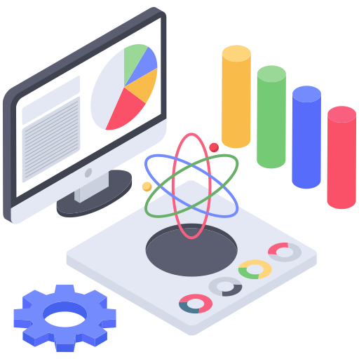


Topic 3 of 6
Expectation Setting
Globally Accepted Master’s Degree
WES Certification
Accepted by MNCs across the Globe
Globally accepted to clear any filter of MSc Degree
Amazon, Google, Facebook, Microsoft
Potential to do PhD in the future
Accepted by any country that otherwise would have accepted an offline degree from the UK

Slide 7
Topic 4 of 6
How to move into Data Science
01
02
03
Set Target
Talk to people
Build LinkedIn Profile
Understand the Data Field,
Understand roles & responsibilities,
Look at a 5-year path
Talk to people who are already doing what you want to do
Add certifications, participate in competitions, do simple projects, look at how the best of the best do it
06
05
04
Build Collaterals & Profile (30%)
Globally Accepted Degree (70%)
Explore Certifications
Multiple certifications don’t help, the quality of it does.
GitHub, LinkedIn,
Medium, Brand Profiling
Globally recognized degree, Degree Accepted by MNCs,
Possibility of PhD later,
Alumni Status
Bonus - WES Certification, Teachers from the industry
Notes:
Source: https://databricks.com/blog/2020/08/20/modern-industrial-iot-analytics-on-azure-part-3.html

Slide 8


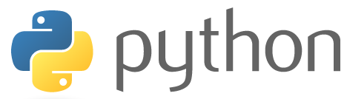


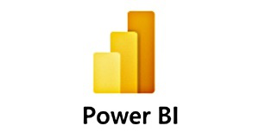
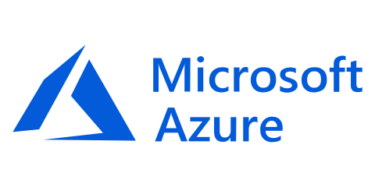



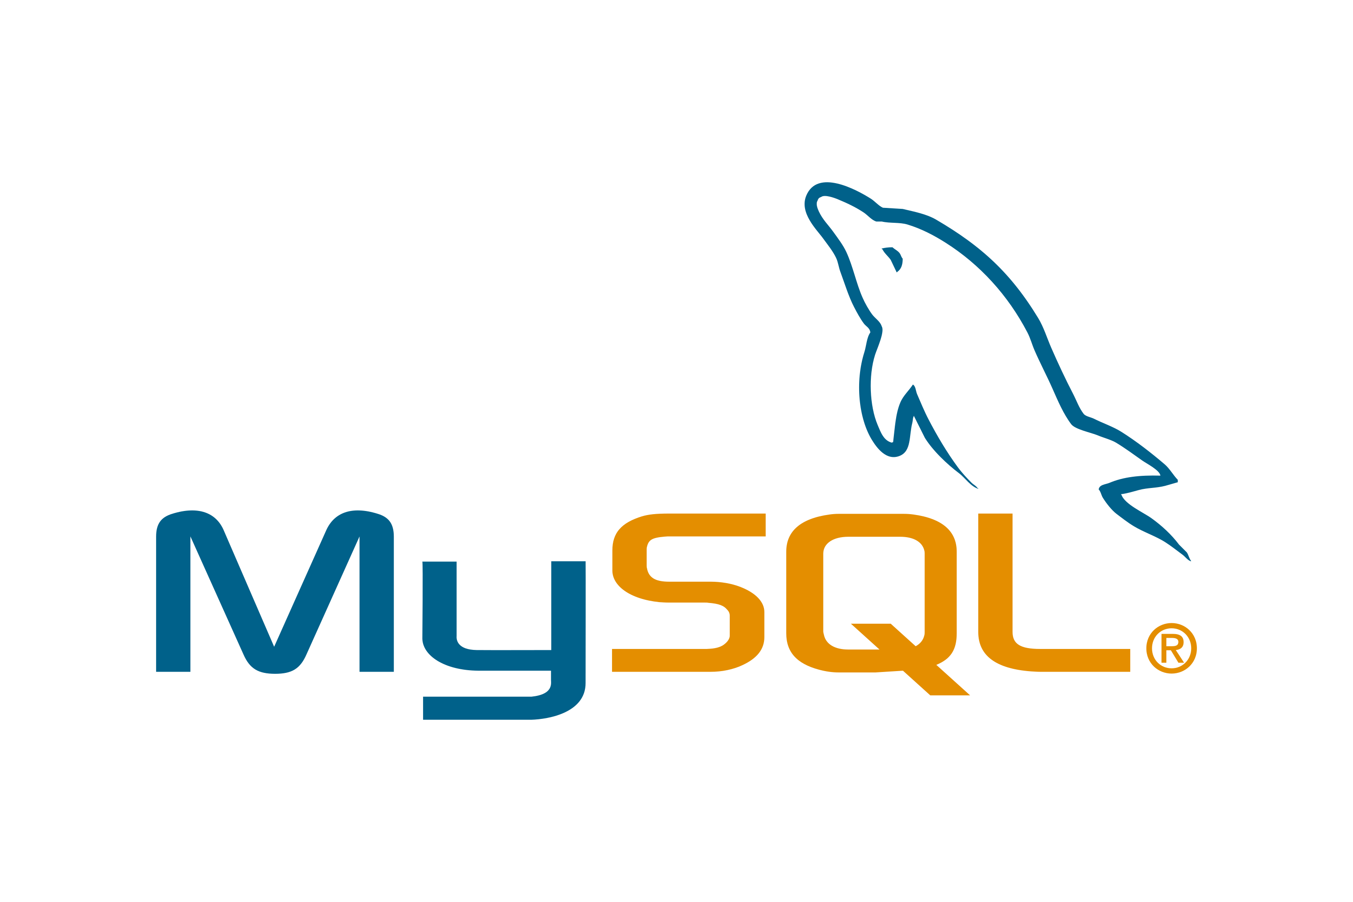

Topic 5 of 6
Tools & Technologies in Data Science
Data Engineer
Machine Learning Engineer
Business Analyst
Data Scientist

Slide 9
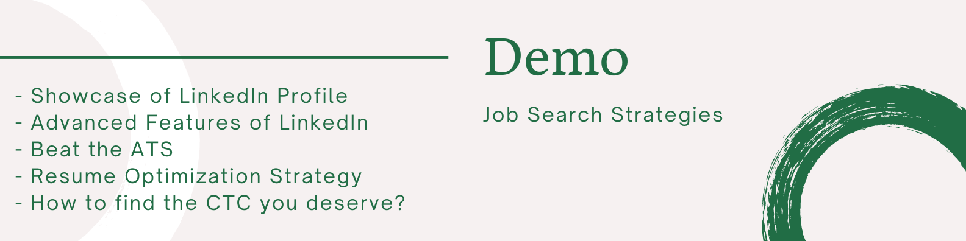





Topic 5 of 6
Resume Optimization (Demo)

Slide 10
Key Takeaways
01
Should you do Master’s?
02
Why do research?
03
How to do it?
04
How to move into Data Science?
05
Tools & Technologies, Job strategies and CTC
06
Next, Let’s Talk!

Slide 11

Evolving research & its importance in the Tech Industry
Anish Mahapatra
Let’s Talk!
LinkedIn: www.linkedin.com/in/anishmahapatra
Email: anishmahapatra01@gmail.com

Slide 12
Evolving research & its importance in the Tech Industry
Anish Mahapatra | 20 November, 2021
Q. How to get into Data Science?
A. Simple, ask a real-world Data Scientist.
Email: anishmahapatra01@gmail.com
Thank you.

